Slide 1
Reflection
Nov-21-2023

Slide 2

AGENDA
WHY PROTECTION
SPRING SECURITY
SPRING SECURITY ARCHITECTURE
FILTER CHAIN
SECURITYCONTEXT
AUTHENTICATIONMANAGER
AUTHENTICATIONPROVIDER
DAO AUTHENTICATION
JWT AUTHENTICATION
OAUTH

Slide 3
WHY PROTECTION
Web application is more or less a outlet where host share resources with others.
But There has to be a way to control who can access those resources and what resources they can access in a web application. So that resources/data can be prevent from accessed by undesirable threads.

Slide 4
THREADS
These are some threads which can be faced by web application.
Injection
XSS (cross site scripting)
CSRF (cross site request forgery)
Session hijack

Slide 5
SPRING SECURITY
Spring Security is a powerful and customizable authentication and access control framework for Java applications, particularly those built using the Spring Framework. It provides comprehensive security services for Java EE-based enterprise software applications.
Spring Security integrates seamlessly with the broader Spring ecosystem, leveraging features such as dependency injection, aspect-oriented programming (AOP), and declarative transaction management. This makes it easy to incorporate security features into existing Spring-based applications.

Slide 6
KEY FEATURES
Authentication
Authorization
Web Security
Session management
Remember me auth
Oauth and OpenId Auth

Slide 7
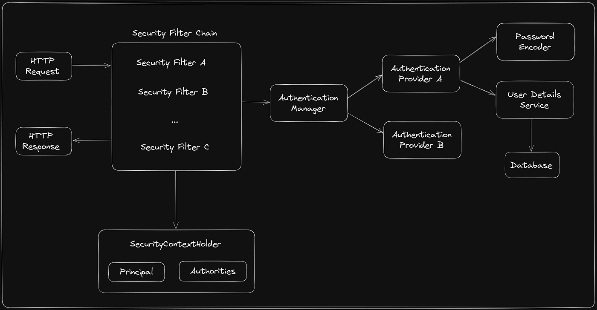
SPRING SECURITY ARCHITECTURE

Slide 8
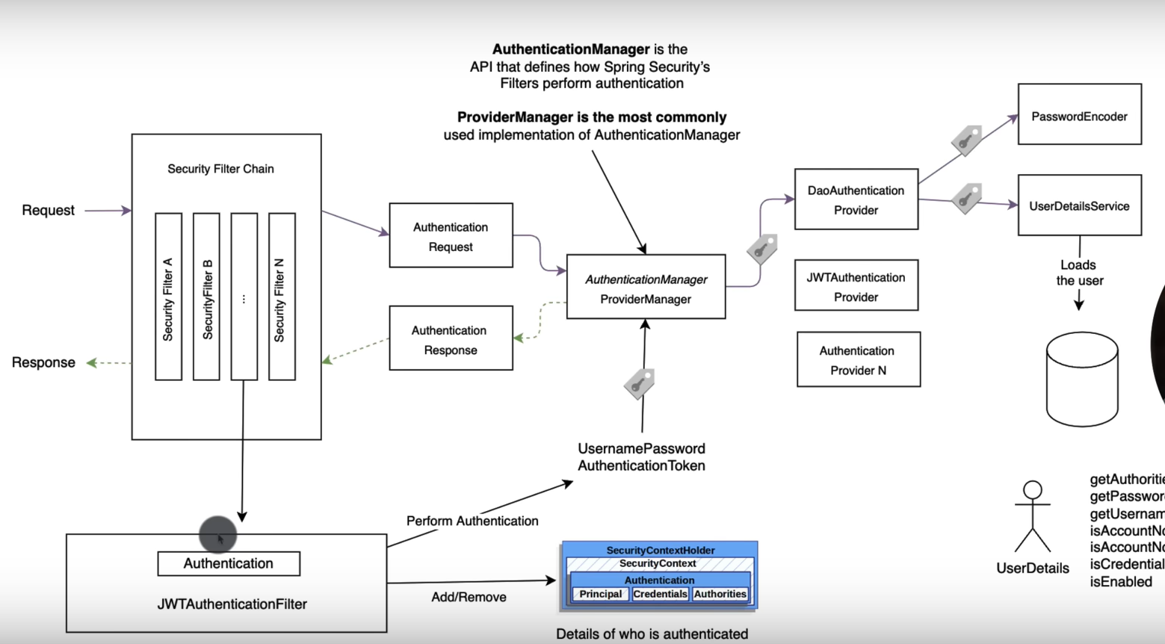

Slide 9
SECURITY FILTER CHAIN
The Security Filter Chain is a crucial component responsible for processing incoming HTTP requests and enforcing security measures such as authentication, authorization, and other security-related tasks. These are component implemented in the javax.servlet.Filter
FILTER TYPES
Security context initializer
Authentication,Authorization
CSRF protection
Session management
Custom filters
Logout

Slide 10
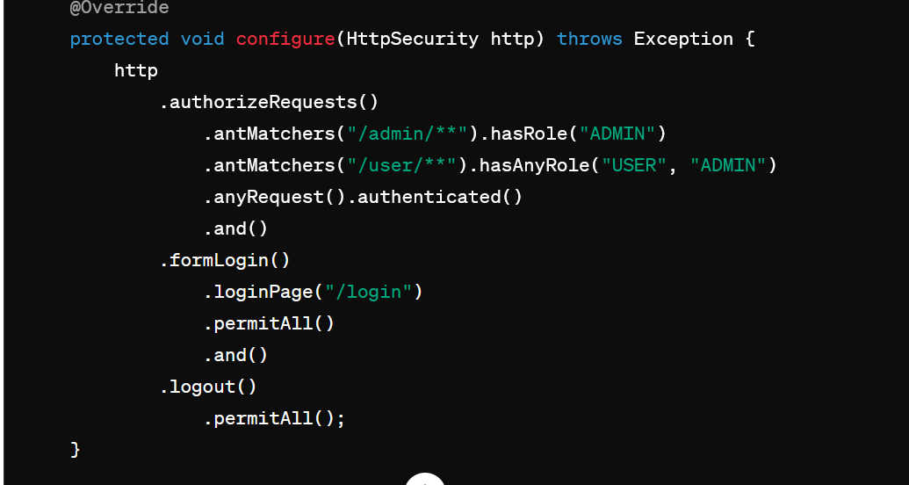
SECURITY FILTER CHAIN
This is filter chain configuration it would be inside a class that extends websecurityadapter class in spring boot in previous spring frameworks this configuration done through XML file.

Slide 11
SECURITY CONTEXT
Security context holds the details of the currently authenticated principal (user) and any granted authorities (roles or permissions). It is typically stored in a Thread local variable, making it accessible to the entire thread processing the current request.
SecuritycontextHolder provides static methods to set and get securitycontext associated with current thread.
SecurityContext context= SecurityContextHolder.getContext();
Authentication authentication = context.getAuthentication();
if (authentication != null && authentication.isAuthenticated()) {
Object principal = authentication.getPrincipal();
Collection<? extends GrantedAuthority> authorities = authentication.getAuthorities();
}

Slide 12
AUTHENTICATION MANAGER & PROVIDER
the AuthenticationManager interface is a core component responsible for authenticating users within an application. It acts as a central point for processing authentication requests and determining whether a user's credentials are valid. The AuthenticationManager typically delegates the authentication process to one or more configured AuthenticationProvider implementations.
Each AuthenticationProvider implementation is responsible for verifying the user's credentials against a specific authentication source. For example, you might have an AuthenticationProvider implementation for database authentication, LDAP authentication, OAuth authentication, or custom authentication logic.

Slide 13
@Configuration
@EnableWebSecurity
public class SecurityConfig extends WebSecurityConfigurerAdapter {
@Autowired
private UserDetailsService userDetailsService;
@Autowired
private CustomAuthenticationProvider customAuthenticationProvider;
@Override
protected void configure(AuthenticationManagerBuilder auth) throws Exception {
// First authentication provider: DaoAuthenticationProvider
DaoAuthenticationProvider daoAuthenticationProvider = new DaoAuthenticationProvider();
daoAuthenticationProvider.setUserDetailsService(userDetailsService);
daoAuthenticationProvider.setPasswordEncoder(passwordEncoder());
// Second authentication provider: CustomAuthenticationProvider
auth.authenticationProvider(daoAuthenticationProvider);
auth.authenticationProvider(customAuthenticationProvider);
}

Slide 14
@Override
protected void configure(HttpSecurity http) throws Exception {
http
.authorizeRequests()
.antMatchers("/admin/**").hasRole("ADMIN")
.antMatchers("/user/**").hasAnyRole("USER", "ADMIN")
.anyRequest().authenticated()
.and()
.formLogin()
.loginPage("/login")
.permitAll()
.and()
.logout()
.permitAll();
}
@Bean
public PasswordEncoder passwordEncoder() {
return new BCryptPasswordEncoder();
}
}

Slide 15
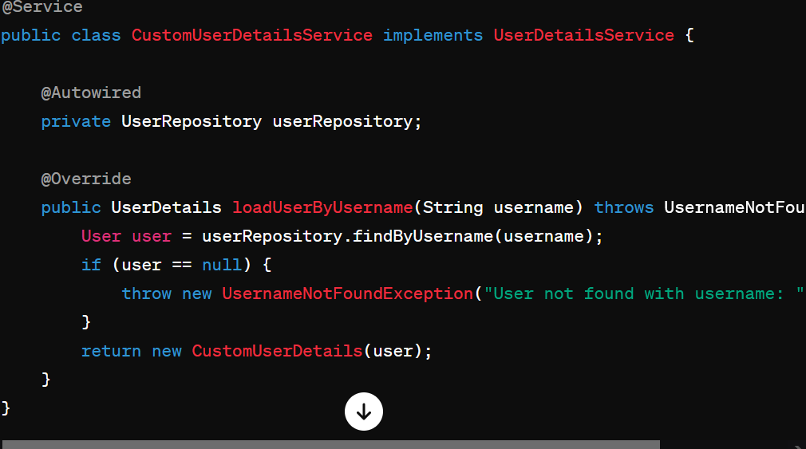
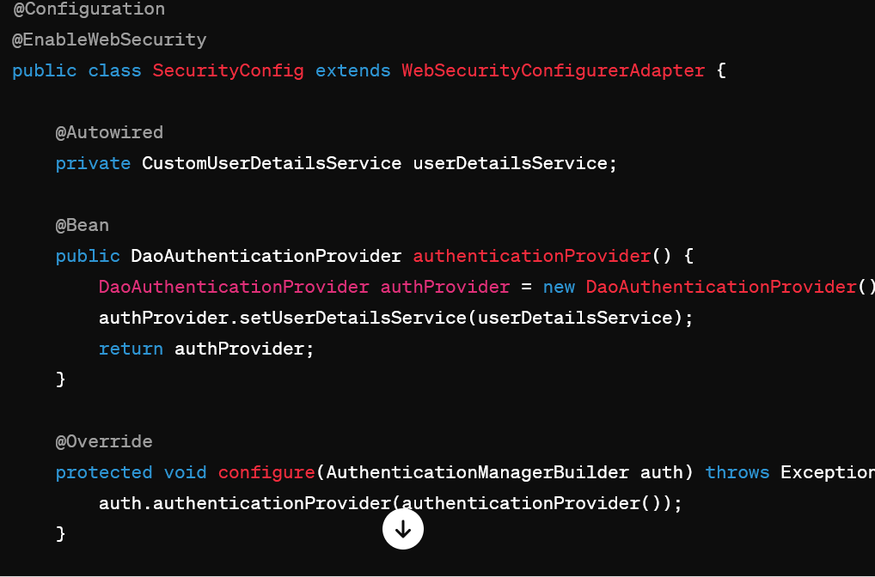
DaoAuthentication

Slide 16
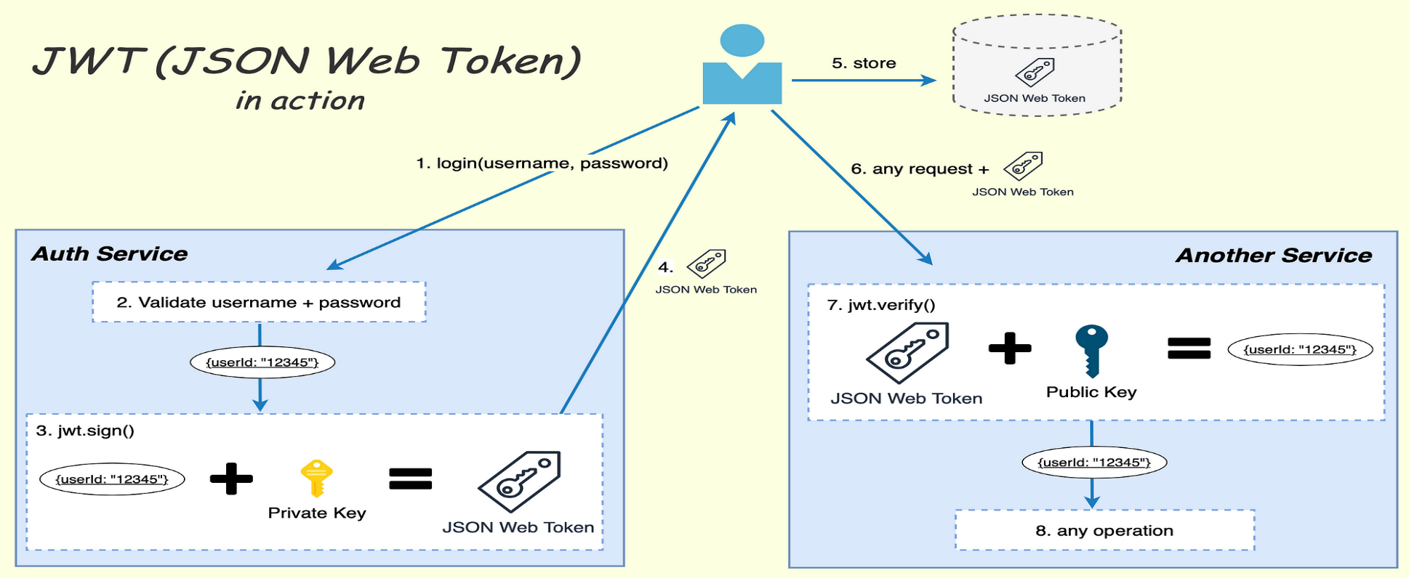
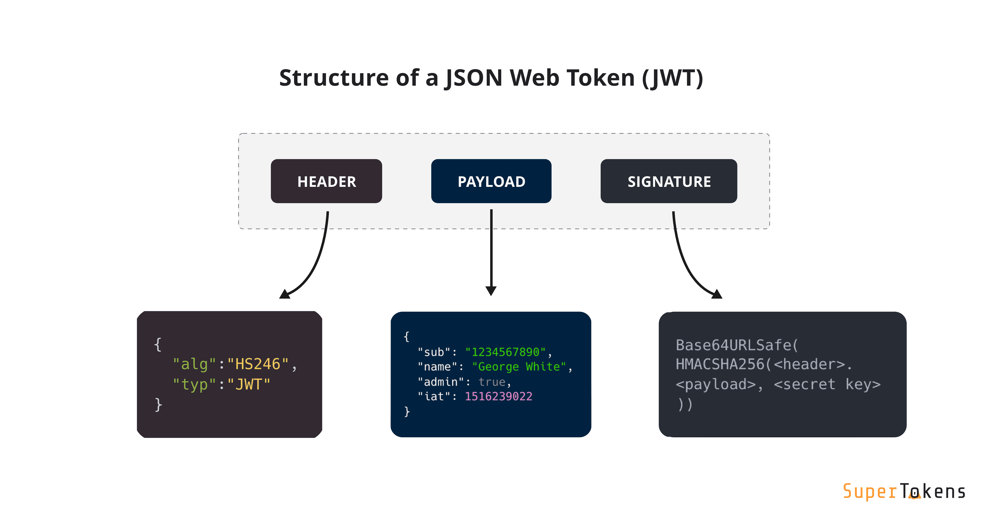
JWT AUTHENTICATION

Slide 17
JWT AUTH CODE - FILTER
@Component
public class JwtAuthenticationFilter extends OncePerRequestFilter {
@Autowired
private JwtHelper jwtHelper;
@Autowired
private UserDetailsService userDetailsService;
@Override
protected void doFilterInternal(HttpServletRequest request, HttpServletResponse response, FilterChain filterChain) throws ServletException, IOException {
String requestHeader = request.getHeader("Authorization");
//Bearer 2352345235sdfrsfgsdfsdf
String username = null;
String token = null;
if (requestHeader != null && requestHeader.startsWith("Bearer")) {
//looking good
token = requestHeader.substring(7);
try {

Slide 18
username = this.jwtHelper.getUsernameFromToken(token);
} catch (IllegalArgumentException e) {
logger.info("Illegal Argument while fetching the username !!");
e.printStackTrace();
} catch (ExpiredJwtException e) {
logger.info("Given jwt token is expired !!");
e.printStackTrace();
} catch (MalformedJwtException e) {
logger.info("Some changed has done in token !! Invalid Token");
e.printStackTrace();
} catch (Exception e) {
e.printStackTrace();
}
} else {
logger.info("Invalid Header Value !! ");
}
if (username != null && SecurityContextHolder.getContext().getAuthentication() == null) {
//fetch user detail from username
UserDetails userDetails = this.userDetailsService.loadUserByUsername(username);
Boolean validateToken = this.jwtHelper.validateToken(token, userDetails);
if (validateToken) {

Slide 19
//set the authentication
UsernamePasswordAuthenticationToken authentication = new UsernamePasswordAuthenticationToken(userDetails, null, userDetails.getAuthorities());
authentication.setDetails(new WebAuthenticationDetailsSource().buildDetails(request));
SecurityContextHolder.getContext().setAuthentication(authentication);
} else {
logger.info("Validation fails !!");
}
}
filterChain.doFilter(request, response);
}
}

Slide 20
JWT WEBADAPTER
@Configuration
@EnableWebSecurity
public class SecurityConfig extends WebSecurityConfigurerAdapter {
private final JwtTokenProvider tokenProvider;
public SecurityConfig(JwtTokenProvider tokenProvider) {
this.tokenProvider = tokenProvider;
}

Slide 21
@Override
protected void configure(HttpSecurity http) throws Exception {
http
.csrf().disable()
.sessionManagement().sessionCreationPolicy(SessionCreationPolicy.STATELESS)
.and()
.authorizeRequests()
.antMatchers("/api/auth/**").permitAll()
.anyRequest().authenticated()
.and()
.addFilterBefore(new JwtAuthenticationFilter(tokenProvider), UsernamePasswordAuthenticationFilter.class);
}
@Bean
@Override
public AuthenticationManager authenticationManagerBean() throws Exception {
return super.authenticationManagerBean();
}
}

Slide 22
JWT UTIL
@Component
public class JwtTokenProvider {
@Value("${jwt.secret}")
private String jwtSecret;
@Value("${jwt.expiration}")
private int jwtExpiration;
public String generateToken(Authentication authentication) {
UserDetailsImpl userDetails = (UserDetailsImpl) authentication.getPrincipal();
Date now = new Date();
Date expiryDate = new Date(now.getTime() + jwtExpiration);

Slide 23
return Jwts.builder()
.setSubject(userDetails.getUsername())
.setIssuedAt(now)
.setExpiration(expiryDate)
.signWith(SignatureAlgorithm.HS512, jwtSecret)
.compact();
}
public String getUsernameFromJwt(String token) {
return Jwts.parser().setSigningKey(jwtSecret).parseClaimsJws(token).getBody().getSubject();
}
public boolean validateToken(String authToken) {
try {
Jwts.parser().setSigningKey(jwtSecret).parseClaimsJws(authToken);
return true;
} catch (SignatureException ex) {
logger.error("Invalid JWT signature");// AND MORE OTHER EXCEPTIONS
return false;
}
}

Slide 24
OAUTH
OAuth (Open Authorization) is an open standard for access delegation, commonly used as a way for Internet users to grant websites or applications access to their information on other websites without sharing their credentials (such as a username and password). OAuth allows users to log in to a third-party service (the service that wants to access their information) using an account they have already established with another service (such as Google, Facebook, or Twitter) without exposing their password.

Slide 25
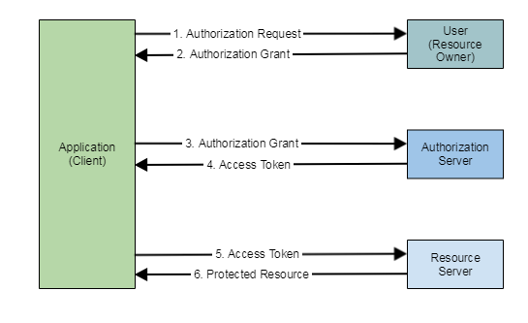
OAUTH

